Slide 1
Top Ten Behaviors for Supporting Student Success
A Strong Start Begins In Early Elementary

Slide 2
Successful students read and are read to Every Day
1.
.

Slide 3
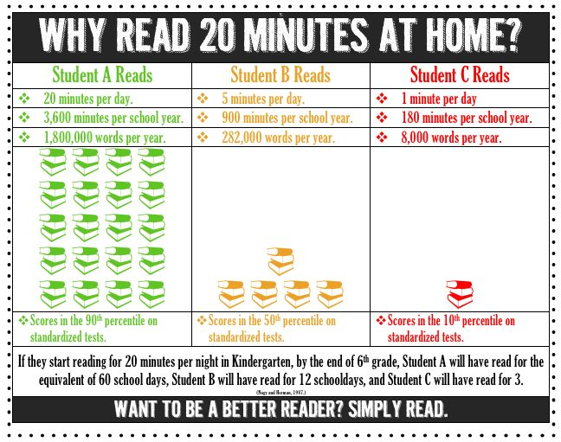

Slide 4
Successful students get enough sleep
2.

Slide 5
Sleep is vital to learning
A child who is overtired may display some of the same behavioral problems caused by attention deficit-hyperactivity disorder (ADHD). From WebMD March 2003
“Children who seem excessively sleepy during the day are more likely to experience problems with learning, attention, hyperactivity, and conduct than kids who aren't sleepy. Sleepiness causes problems with concentration and mood, and can even make it hard for students to stay awake in class…even 9:00 p.m. is a late bedtime for an elementary school child.”
National Sleep Foundation

Slide 6
How Much Sleep Is Enough?
“Pointing out that adequate sleep is essential to a child's academic success and overall well-being, the researchers said that 3- to 5-year-olds need at 11 to 13 hours of shut-eye per night. Five to 12-year-olds need at least 10 or 11 hours a night.” Mayo Clinic

Slide 7
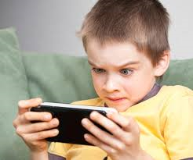
Successful students have limited screen time
3.

Slide 8
Effects of too much screen time
The American Academy of Pediatrics discourages media use by children younger than age 2 and recommends limiting older children's screen time to no more than one or two hours a day. Too much screen time has been linked to:
•Obesity. The more TV your child watches, the greater his or her risk is of becoming overweight. Having a TV in a child's bedroom also increases this risk. Children can also develop an appetite for junk food promoted in TV ads, as well as overeat while watching TV.
•Irregular sleep. The more TV children watch, the more likely they are to have trouble falling asleep or to have an irregular sleep schedule. Sleep loss, in turn, can lead to fatigue and increased snacking.

Slide 9
Effects of too much screen time
.
•Behavioral problems. Elementary students who spend more than two hours a day watching TV or using a computer are more likely to have emotional, social and attention problems. Exposure to video games is also linked with an increased risk of attention problems in children. Watching excessive amounts of TV at age 4 is linked with bullying at ages 6 through 11.
•Impaired academic performance. Elementary students who have TVs in their bedrooms tend to perform worse on tests than do those who don't have TVs in their bedrooms.
•Violence. Too much exposure to violence through media — especially on TV — can desensitize children to violence. As a result, children might learn to accept violent behavior as a normal way to solve problems.
•Less time for play. Excessive screen time leaves less time for active, creative play.

Slide 10
Successful students have child sized worries
4.

Slide 11
Sometimes children can feel “emotionally burdened” by adult issues such as
moving, divorce and finances.
“As parents, our job is to teach our children to thrive in this world while simultaneously protecting them.
Sometimes during this process, we inadvertently place emotional burdens on them.
When this happens, (and it happens to all parents) don’t spend your time feeling guilty
because feeling guilty does not solve any problem. Spend your time helping your child
learn how to appropriately handle his emotions and learn to understand your own
emotions and deal with them so that your children can enjoy childhood and not be
overburdened by adult emotions.” Bellaire Counseling, 2013

Slide 12
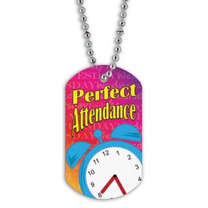
Successful students have excellent attendance
5.

Slide 13
DID YOU KNOW?
•Starting in kindergarten, too many absences can cause children to fall behind in school.
• Missing 10 percent (or about 18 days) can make it harder to learn to read.
•Students can still fall behind if they miss just a day or two days every few weeks.
• Being late to school may lead to poor attendance.
•Absences can affect the whole classroom if the teacher has to slow down learning to help children catch up.
Attending school regularly helps children feel better about school—and themselves. Start building this habit in preschool so they learn right away that going to school on time, every day is important. Good attendance will help children do well in high school, college, and at work. Michigan Dept. of Education

Slide 14
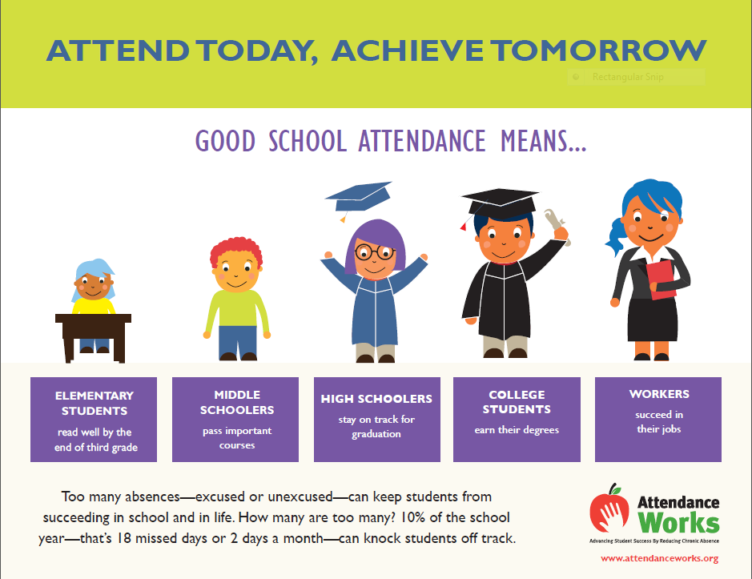

Slide 15
Successful students have a strong work ethic
responsibilities that are expected to be completed well, persevere at tasks, cope with small amounts of frustration, stick to it
6.

Slide 16
Perseverance is the ability and drive to start and continue steadfastly on the path towards any goal you set.
“Teaching our children to build a strong work ethic is developed through consistent repetition…It is stated that it takes twenty-one days to build a habit, whether it is good or bad, before it becomes routine. Work ethic is something that is not learned over night, or in a day. It is built upon by repetition and routine.” Dr. Wm. Morse

Slide 17
Successful students hear positive talk about school
Knows parents value ed, respect for teachers
7..

Slide 18
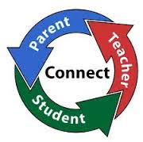
Doing well in school is important in our family.
We want you to learn and do well.
We expect you to try your best and to work hard.
“The teacher and parent should really be a team in molding a child's education, The child needs to thrive in that environment and trust their teacher. Parental attitudes toward school could influence the child's behavior in the classroom and at school.“ Dr. L. Zellinger

Slide 19
Successful students have daily routines
8..

Slide 20
Benefits of routine
Provides children a sense of time; a way to make sense of their day
Provides security and predictability
Forms good habits
Lessens anxiety
Lessens power struggles, child knows what is expected
Helps child get onto a schedule
Helps child handle change more easily

Slide 21
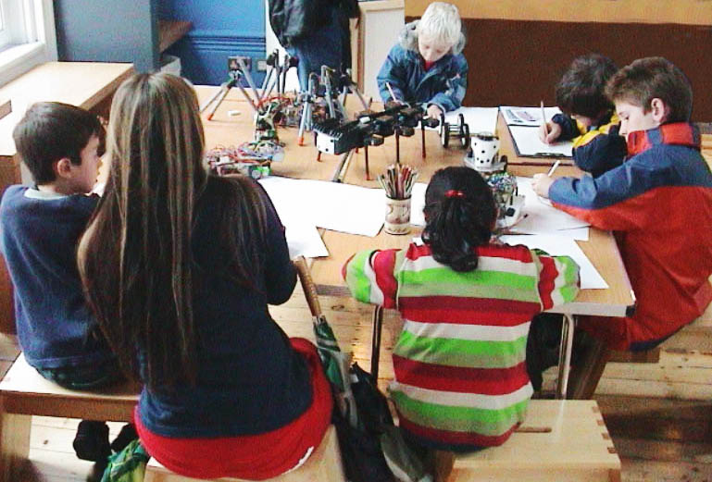
Successful students know how to act when in a group
9..

Slide 22
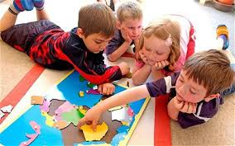
Successful group behavior…
Waits for a turn to talk
Listens and responds to others
Understands attention from teacher must be shared
Can problem solve
Is helpful to others

Slide 23
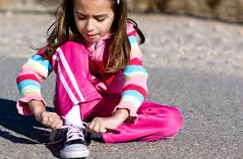
Successful students are learning to be independent
10..

Slide 24
INDEPENDENT BEHAVIORS APPROPRIATE FOR K-2
Tie shoes
Zip or button coat
Hang up coat and backpack
Put on shoes and boots
Personal hygiene

Slide 25
